Slide 1
Template guidance - Read me
This template has been designed and approved for powerpoints for the Proteus Partnership. To ensure presentations get approved and not rejected, please follow the template and the following guidelines:
Ensure that the grey box is on every slide (this has to be done manually) and that it is at the front of all images (click bring to front) and in the same position – consistency is key
Avoid using BOLD font in Title/Chapter Slides
Use Roboto text for content-slide headings and Roboto Light for body text
Use Roboto Light for title slide heading
Keep slides simple with as little text as possible
Make sure you use a range of images from the pre-approved image library (see below) - use no single image more than once
All images should be cropped and formatted to match the allocated areas in the slides
Please choose images from the pre-approved image folders located here:
Content Slide images
Title Slide images

Slide 2
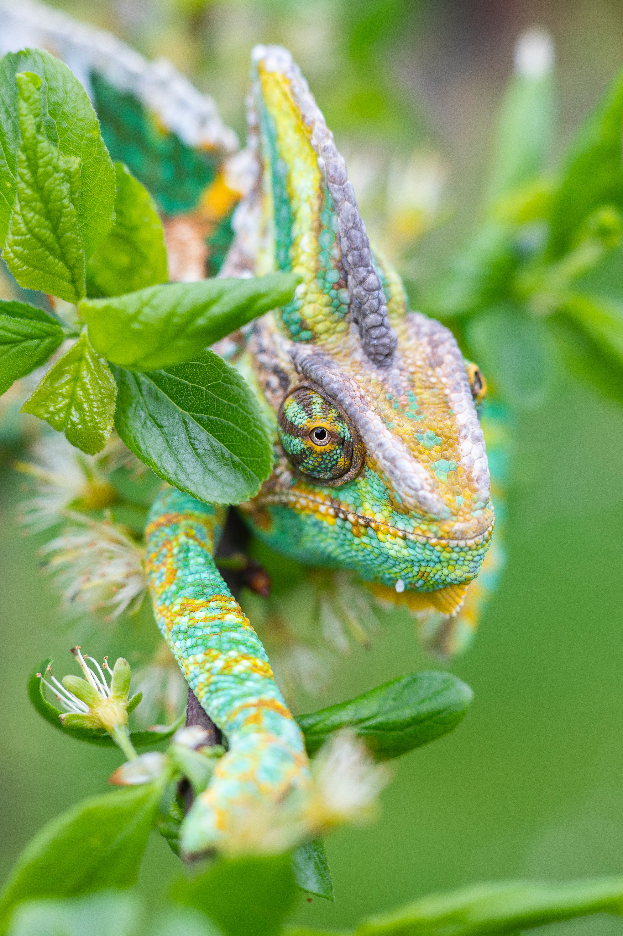
Monitoring framework for the Kunming-Montreal Global Biodiversity Framework
Natasha Ali, Policy, UNEP-WCMC
9 November 2023
Notes:
Biodiversity credits: insights, challenges and opportunities
Maria Antonova, Nature-based Solutions, UNEP-WCMC
Alessandro Valentini, Specialist, Sustainable Finance, WEF
Manesh Lacoul, Global Coordinator, Biodiversity Credit Alliance
Rodrigo Cassola, leads our Finance for Nature Focal Initiative, UNEP-WCMC

Slide 3

Proteus Horizon Scan Webinars
A series of webinars for Proteus Partners sharing information and insights into the latest trends and developments in biodiversity and ecosystem services policy, initiatives, data and tools.
Notes:
I’ll start with a bit of housekeeping,. I think that many of you have attended one of these sessions before, but for anyone who hasn’t, this is part of the Horizon Scan webinar series that UNEP-WCMC run for Proteus Partners.
There are four webinars each year, focusing on new and emerging topics and trends in biodiversity including new tools, updates to guidance, policy developments and upcoming initiatives.

Slide 4
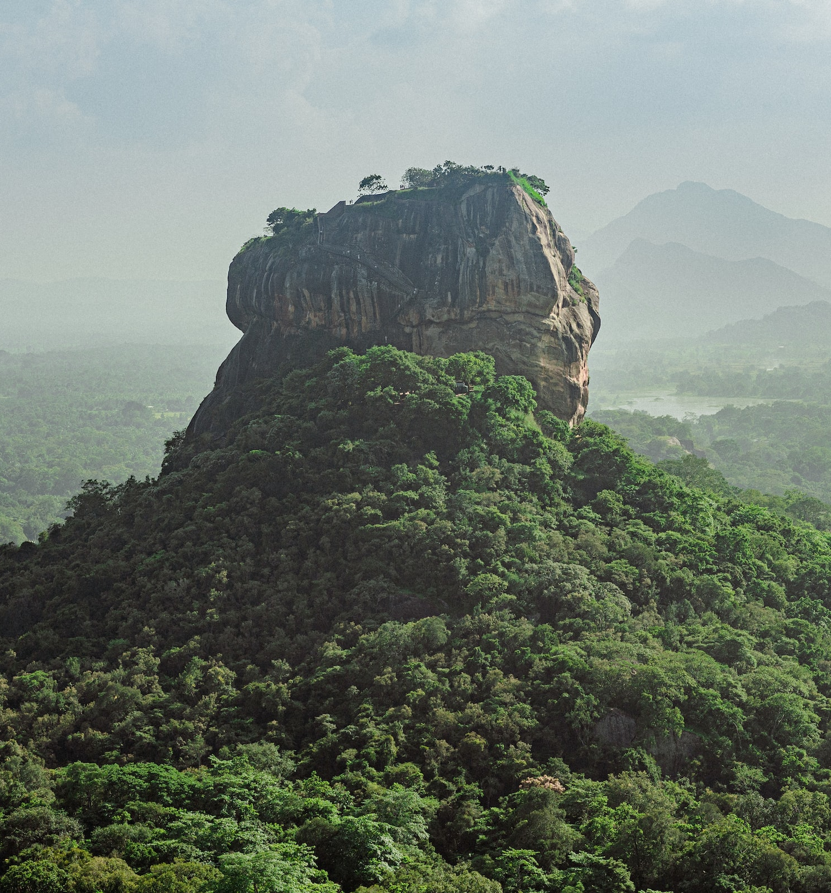
Logistics
Scheduling: AM and / or PM sessions
Rules: Chatham House rule for discussion, but presentation is recorded
Topics: Your suggestions are welcome!
Notes:
We do also record the main presentation section of the webinar and make it available through our website for anyone who isn’t able to make the live sessions. Please do circulate the link to the recording to your colleagues and encourage them to get in touch if they have any questions.
As per the slide here, we conduct the discussion part of the session under the Chatham House Rule so please do view these sessions as an opportunity to ask questions and share your insights and thoughts. We have lots of time today for discussion so we really appreciate it if you are able to turn your camera and microphone on and join in. There’s a lot of experience in this room and I know it will be interesting to get your thoughts and opinions on nature markets and biodiversity credits.
You’re also very welcome to post comments or questions in the chat box as we go along and we’ll address all questions at the end.
Finally, I wanted to take this opportunity to ask for your suggestions for potential future Horizon Scan webinar topics – we’re always keen to know what partners would like to hear more about through these webinars.

Slide 5

AGENDA
Understanding Biodiversity credits
Exploring case studies of innovative finance mechanisms
The Biodiversity Credits Alliance
Questions and discussion
Close remarks
Notes:
Maria is going to give a bit of background on the current landscape of biodiversity credits
There will be a short Menti quiz during this section and I’ve popped the details for this in the chat
Then Alessandro is going to talk about WEFs biodiversity credits initiative and a case study
Finally we’ll go to Manesh who will introduce the Biodiversity Credit Alliance’s work and how you can get involved.
The presentations will last about 30 minutes and then we have another 30 minutes (up to an hour if we need it) for dsicussion
HAND OVER TO MARIA

Slide 6

Understanding Biodiversity credits
Maria Antonova, Nature-based Solutions, UNEP-WCMC

Slide 7
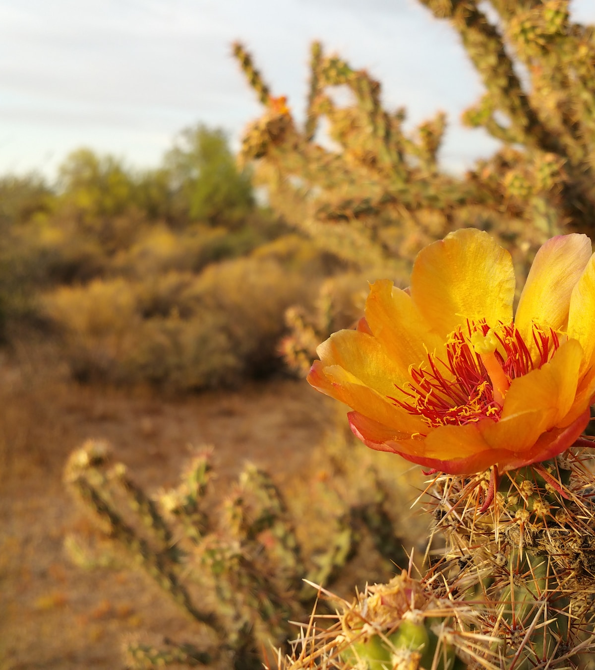
Setting the scene / Menti poll
Definitions and concepts
Key uncertainties and principles
Current landscape
Future outlook

Slide 8

Setting the scene: how did we get here?
Global consensus on biodiversity crisis
Nature finance gap
Kunming-Montreal Global Biodiversity Framework (Target 19):
“innovative schemes such as payment for ecosystem services, green bonds, biodiversity offsets and credits, benefit-sharing mechanisms, with environmental and social safeguards”.
Notes:
[DRAFT]
-Very brief background on accelerating nature loss and risks of biodiversity crisis and link to climate crisis
-Nature finance gap and need to drive private investment in conservation and restoration
-History of biocredits – have they been around a long time?
-COP 15, buzz around biocredits, explicit mention in the text. Why it’s important that it’s in the GBF, high-level interest at Libreville, other key recent events around the topic

Slide 9

Menti poll
Got to menti.com and use the code 2773 1166
Why is your company interested in biodiversity credits?
As a way to support nature projects
To help meet company’s targets for nature
As an investment (can increase in value over time)
To help mitigate company’s impact (an offset)
Interested in learning more but wouldn’t buy them yet
Other
Notes:
Menti poll:
Structure of Menti – maybe have options to choose from instead of having them type in the answer in the interest of time. Could also let them know ahead of the webinar that they will be asked this question
Why is your company interested in biodiversity credits?
Interested in learning more but wouldn’t buy them
They are a better way to support nature projects
They can help meet company’s targets for nature (e.g. TNFD)
They are a good investment and can increase in value over time
They can help mitigate company’s Impact
-Other
Link to the Menti poll - https://www.menti.com/ali5kvru7gcq

Slide 10


Carbon vs. Biodiversity
Notes:
Voluntary carbon markets where carbon credits are bought with the goal of meeting climate targets have been around a long time. Carbon credits can also serve as an instrument to channel finance into nature conservation and restoration of carbon-rich ecosystems. Many of the currently developing schemes for biodiversity credits are being done by existing carbon standards and carbon developers are looking into developing biodiversity credits.
Quantifying carbon credits is a lot more straightforward than quantifying biodiversity however, and this is one problem with defining biodiversity credits. One ton of carbon dioxide is the same no matter where and how it is being stored or sequestered, in an Amazon jungle or a mangrove in Indonesia. But because nature is so complex and diverse, quantifying and commodifying a nature unit that would align how biodiversity is measured in different parts of the world where ecosystems and species are completely different.

Slide 11
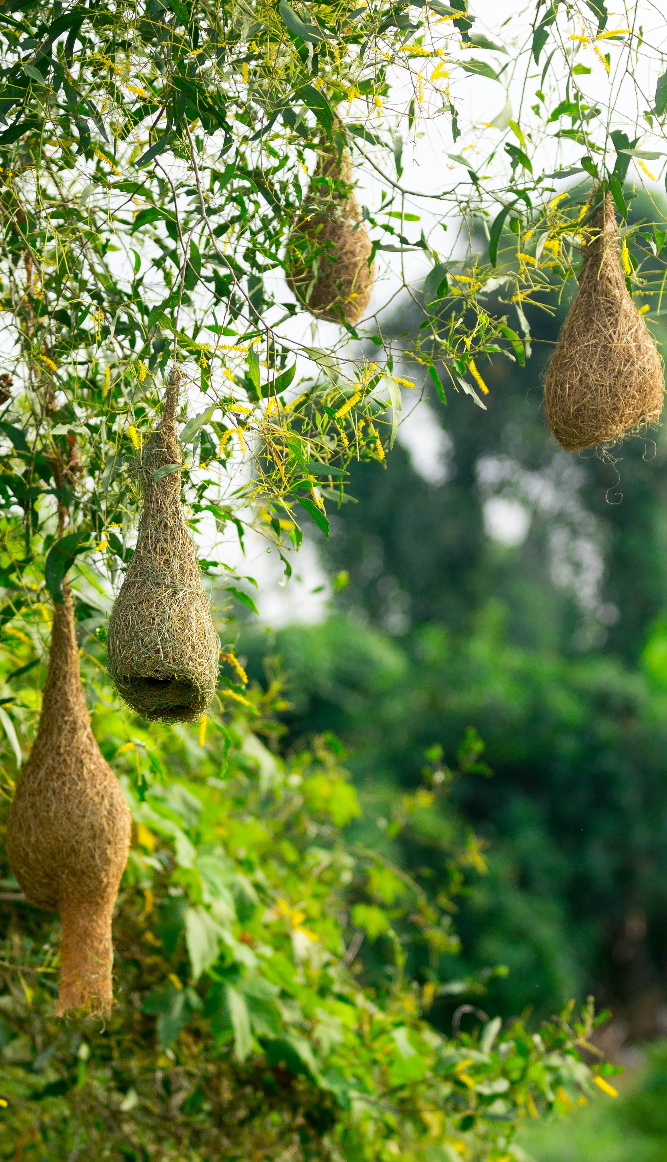
Defining biodiversity credits
“quantifiable unit representing a biodiversity conservation and/or enhancement claim, which cannot be used as an offset” (GEF)
“a certain “amount” of "biodiversity gains" generated on the ground and expressed in a "standard unit"” (Organisation for Biodiversity Certificates)
“an economic instrument used to finance activities that deliver net positive biodiversity gains” (WEF)
Notes:
What are biodiversity credits?
Despite the interest and research happening around this topic, there is no agreed upon definition of what a biodiversity credit is. The term itself for a unit of biodiversity can vary. These have been called ‘biodiversity credits’ as well as ‘nature credits’, certificates or tokens.
Useful links:
GEF: https://www.thegef.org/sites/default/files/documents/2023-03/GEF_IIED_Innovative_Finance_Nature_People_EN_Summary_2023_03.pdf
Organisation for Biodiversity Certificates: https://www.obiocert.com/wp-content/uploads/2022/11/Towards_biodiversity_certificates_proposal_for_a_methodological_framework.pdf
WEF: https://www.weforum.org/agenda/2022/12/biodiversity-credits-nature-cop15/

Slide 12
Key uncertainties / risks
Offsets vs. “Nature Positive” and claims
Nature protection vs. restoration
Questions over leakage
Secondary market or not?
What metric to use?
What is the common goal? (e.g. Net Zero)
Climate change
Social impacts and appropriate safeguards
Notes:
The biodiversity credit space is fast evolving and many uncertainties are still unresolved
The thought leadership on the subject has arrived at a consensus that biodiversity units should not be used to offset the company’s biodiversity footprint. Offsets are traditionally a different type of mechanism that is mandatory for development activities and highly localised. A credit produced by a project in the African savannah is not ecologically equivalent to destruction caused by development in Indonesia’s peatland forest and there is no way this equivalence could be established or verified. So existing standards developing biodiversity credits have specified that these are not to be used as offsets but instead be a voluntary nature positive contribution, but this raises the question of what the investing company will be able to claim after purchasing the credits.
There are different approaches toward what can generate the value of a biodiversity credit, restoration of nature that will cause an uplift of biodiversity, or protection of nature that would be destroyed otherwise. From carbon markets it’s becoming clear that quantifying the value of avoided loss is highly uncertain, and is likely to be even more uncertain with biodiversity. However only valuing uplift in nature will disadvantage highly biodiverse intact landscapes with communities that have the biggest need in finance to continue their stewardship, and favour places where nature has already been impacted negatively.
Leakage is an issue that has plagued the carbon markets, while with carbon there is at least in theory a way to account for leakage with country emissions data, with biodiversity no such frameworks exist. It will be extremely difficult to quantify whether interventions to increase in biodiversity in a project area are causing nature destroying activities to simply move elsewhere, achieving zero biodiversity benefit.
With carbon, credits can be traded before they are retired. What the transactional chain will be for biodiversity credits is currently unknown.
As seen on the previous slide, there is no clearly defined way to measure a unit of biodiversity. When we don’t even know all of the species that exist on this planet, what do we use as a proxy? Bird diversity? Area of intact forest? The various emerging schemes all approach this in different ways and using different metrics. So biodiversity credits from different schemes and standards will represent different things.
While with carbon the rationale behind the market for voluntary credits is clear, Net Zero, it’s not yet clear what this rationale is for a biodiversity credit market. With different types of credits, each measured with different metrics and applied by very different types of projects, it is difficult to see this converging and driving the market.
Climate change is affecting nature in profound ways causing animal populations to migrate, weather patterns to change and species to disappear. Quantifying biodiversity credits requires achieving an increase of biodiversity toward a state that is not depleted by human activities. But what if that state is no longer achievable due to climate change? How do we account for this?
Social impacts - The literature on social aspects of conservation shows that projects that do not consider local peoples’ well-being, or that use and entrench local power imbalances, have a high risk of failure (Dawson et al., 2021). Biodiversity credits that do not address such issues would be poor investments. There is an opportunity for biodiversity credit schemes to be designed through a fair and inclusive process, when including strong social safeguards applied based on existing principles and guidelines. These could include: ensuring no net loss – or ideally positive outcomes – for people as well as biodiversity. Source: https://www.thebiodiversityconsultancy.com/fileadmin/uploads/tbc/Documents/Resources/Exploring_design_principles_for_high_integrity_and_scalable_voluntary_biodiversity_credits_The_Biodiversity_Consultancy__1_.pdf

Slide 13
Potential Integrity principles
Integrity:
Deliver positive biodiversity outcomes benefiting nature and people;
Drive finance to nature conservation and restoration activities that can help meet the Kunming Montreal Global Biodiversity Framework (GBF) goals and targets;
Equity: respect and safeguard the rights of IPLCs, promoting engagement to ensure benefits on the ground
Quality: measurable biodiversity outcomes supported by scientific evidence
Ensure transparent reporting of project impacts to manage the risk to credit buyers
Not being used for offsetting purposes
Fair pricing
Notes:
While there is a diversity of opinions about what biodiversity credits are and what they represent, various stakeholders are attempting to develop high-level principles to guide this nascent market along the right path.
Added from Rodrigo's comments: There is no authoritative set of principles yet, and that this is something being discussed by different groups.
The guiding principles provide the basis on which Verra is developing the Nature Framework to certify Nature Credits representing real, measurable, and verified positive biodiversity outcomes; and are not to be confused with safeguards for project design and implementation. (principles from Vera – Integrity, Equity, Quality, and transparent reporting).
One of these principles is that the biodiversity credits should not be used to mitigate damage within a company’s mitigation hierarchy and be treated as offsets. These credits are voluntary, are generated outside the company’s supply chain and are not tied to its operations. Seen on their own, outside the context of how a company is addressing its direct impacts on nature, biodiversity credits are not enough for a robust claim of ‘Nature Positive’ although. The TNFD Framework classifies biodiversity credits as an opportunity for capital flow and financing but does not specify what they can be specifically used for. More clarity and guidance may be necessary.
Sources:
Position-Statement_Biodiversity-Credits_Fauna-Flora_Sept23_clean.pdf
‘Nature positive’ must incorporate, not undermine, the mitigation hierarchy | Nature Ecology & Evolution
Guidance_on_the_identification_and_assessment_of_nature-related-issues_The_TNFD_LEAP_approach_v1.pdf
Fair pricing:
This extends from the point above. Experience from the carbon markets suggests that prices on carbon in many of the emission reductions agreements do not adequately reflect the cost of protecting forests incurred by the stewards on the ground. Therefore prices of biodiversity credits should be enough to implement the work required to conserve or restore nature, and to ensure benefits from these credits are shared fairly.
Position-Statement_Biodiversity-Credits_Fauna-Flora_Sept23_clean.pdf
Additionality, leakage, permanence
These are the three pillars of a robust carbon credit which should also extend to any biodiversity credits. Any biodiversity credits issued from a project should represent benefits to biodiversity that would not have happened without funding from the sale of credits, that don’t simply move damaging activities outside the project areas, and that are going to have long-term effect and sustainability.
WEF_Biodiversity_Credits_Markets_Integrity_and_Governance_Principles_Consultation.pdf (weforum.org)

Slide 14
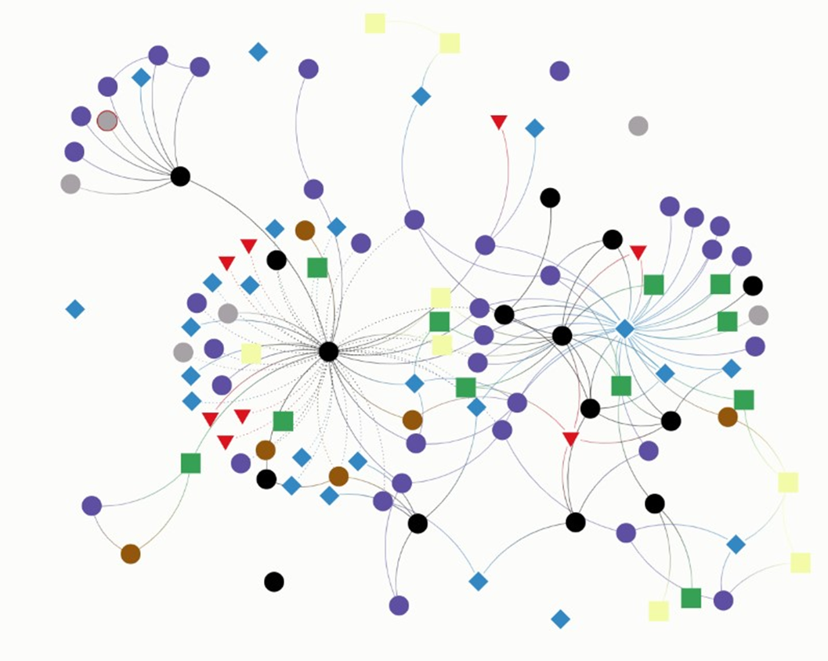
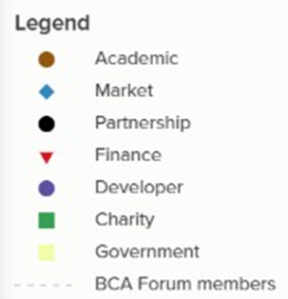
Stakeholders involvement with biodiversity credits
Examples:
Partnerships: Biodiversity Credit Alliance
Standards: Verra’s Nature Framework​ and Plan Vivo (PV Nature)
Developer: rePlanet​, Credit Nature, and Terrasos​
Notes:
The map is a visual representation of a database which categorises organisations and entities with known involvement in the biodiversity credit space and existing relationships.
The entities are categorised into seven groups based on their organisation type, and further tagged according to the type of involvement in biodiversity credits.
These include academic institutions, companies with capacity to drive and upscale the market (for example brokers already operating in the space of ecosystem services or consultancies working primarily with the demand side). Partnerships are groups of organisations, of which the biggest one is the Biodiversity Credit Alliance.
It is also clear from the assessment of the stakeholder map that many of the actors have branched into biodiversity credits from voluntary carbon markets. Two of the key initiatives on biodiversity credits stem from the existing carbon standards Verra and Plan Vivo. It is clear that many of the members of Verra’s task force working on biodiversity credits are existing carbon project developers. Brokers selling carbon offsets are also becoming involved in the biodiversity credit space.
Note that while Verra made the composition of its task force public, we do not know the participants in the Plan Vivo biodiversity credits working groups, which may explain the lack of connections around the Plan Vivo standard.
Developers are organisations building projects on the ground or consultancies working primarily with the ‘supply’ side of the market, such as rePlanet , Credit Nature, and Terrasos. Charities are mostly non-governmental organisations (NGOs) with a conservation focus who are unlikely to participate in the market directly. Government are parts of government or UN organisations such as UNEP.
Notes:
Due to the rapid nature of this assessment the categorisation of entities on the map and connection between them was mostly based on publicly available information online on organisational websites, press-releases or news reports. Due to the rapidly evolving nature of the biodiversity credit landscape, with new taskforces and initiatives forming on a monthly basis, the map is most likely incomplete and serves as a quick snapshot in time. In some cases, initiatives are so new that it is impossible to understand their nature or mechanism, making any categorisation difficult (for example, the Positive Conservation Partnerships announced by Macron in Gabon)y.
Source: https://kumu.io/UNEP-WCMC/biodiversity-credit-stakeholder-map#stakeholdermapv1/

Slide 15

Future outlook
Where will credits come from? (supply side)
Who will buy them? (demand side)
How will it be governed?
Can it be scaled up?
Notes:
For a biodiversity credit market to work, there should be a supply of credits. Currently there are pilots being developed within the various schemes including Verra and Plan Vivo.
From the demand side, companies are just beginning to develop their biodiversity strategies, so it remains to be seen how biodiversity credits can fit into these. The various guidances like TNFD are also likely to develop further their recommendations about how to report various nature investments including biodiversity credits.
The policy environment and governance of biodiversity credit market would be key to avoiding the various problems we’ve had with carbon market. It is not currently clear how the various integrity principles will be implemented and whether there will be some kind of biodiversity credit integrity council.
Finally, the role of biodiversity credits also remains to be seen – will they be able to become a considerable source of funding to close the biodiversity finance gap? This needs to happen at scale, but to scale up you have to get key things right.

Slide 16
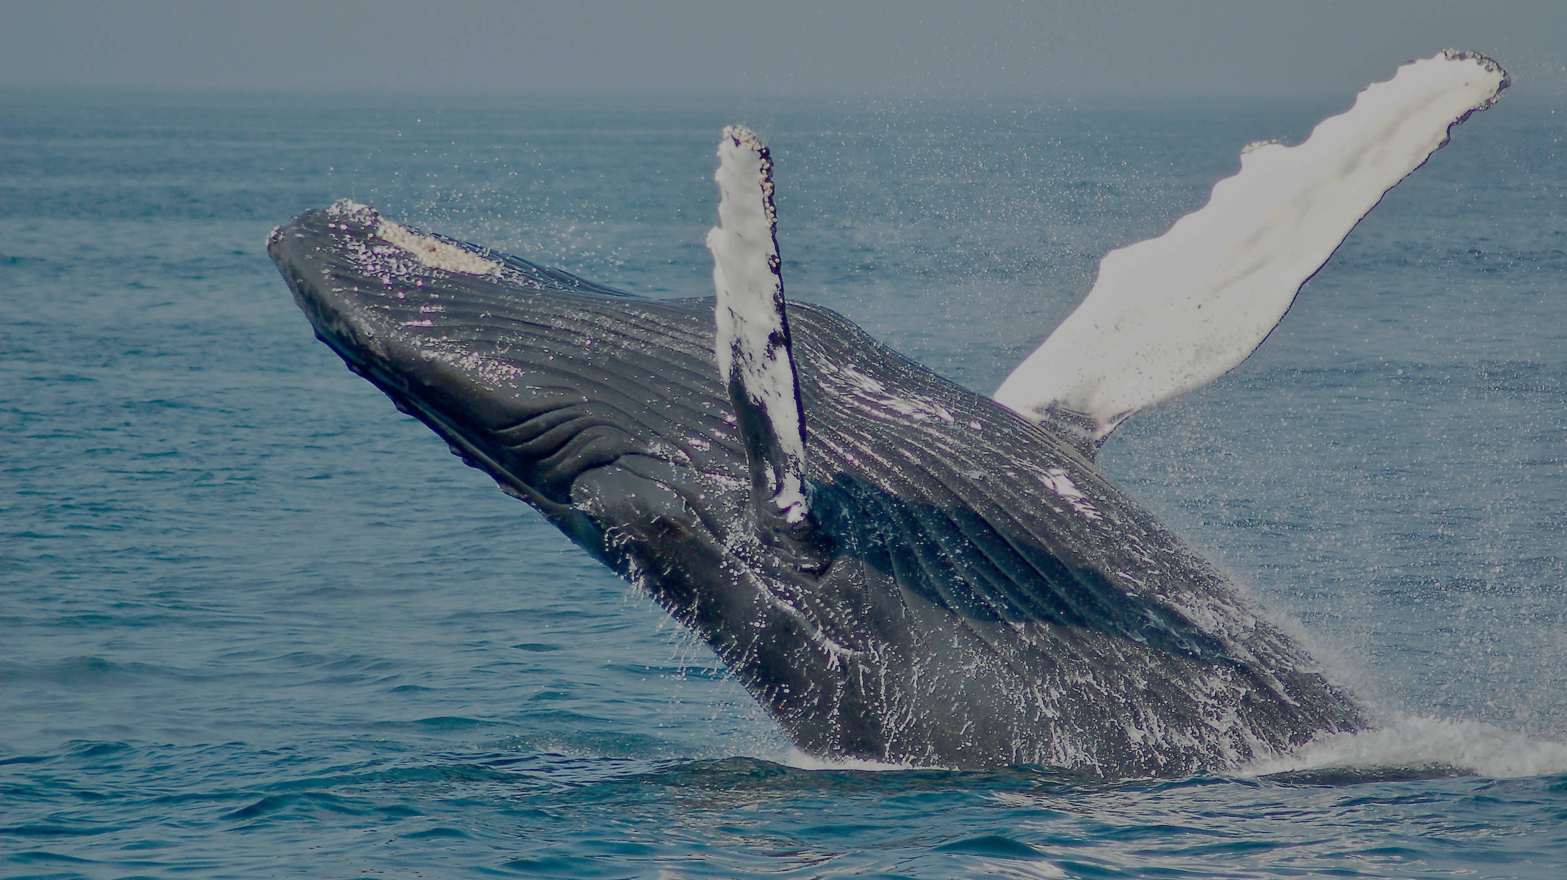
World Economic Forum
Alessandro Valentini, Specialist, Sustainable Finance, WEF

Slide 17

Biodiversity Credit Alliance
Manesh Lacoul, Global Coordinator, Biodiversity Credit Alliance

Slide 18
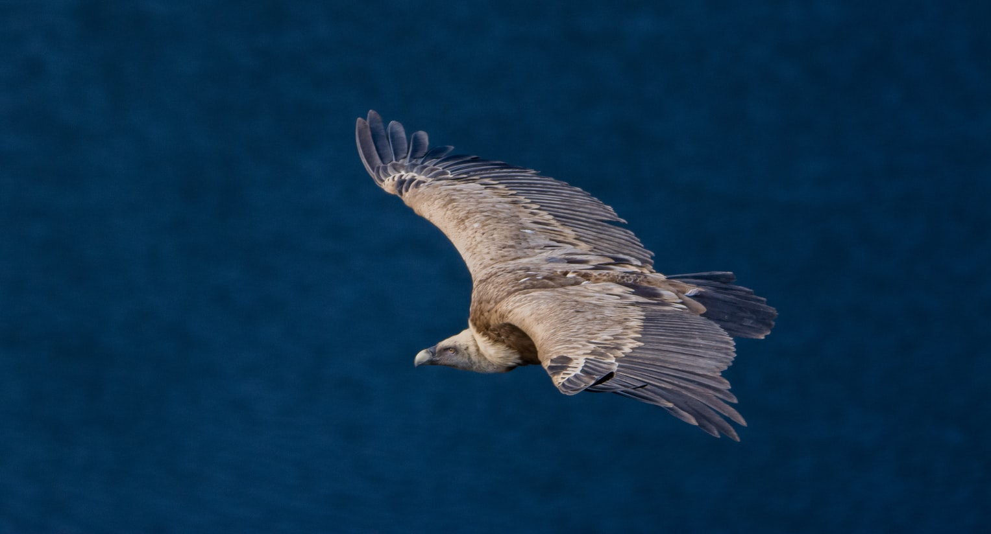
Thank you

