Slide 1
How to use this slide deck
This slide deck has been developed by UNEP-WCMC and presents key resources and material to explore The Business Case for Biodiversity Management. It is intended that this will be used as a complete deck to ensure that full information is presented.
This slide deck has been produced for internal use by Proteus Partners. Accompanying speaker notes lay out the key points for each slide. Speaker notes in Bold outline key points, while notes in Italic provide supporting information.
For slide-specific content, the sources are provided in the speaker notes. Slide 33 provides an overview of relevant literature related to business and biodiversity.
For further information or questions on The Business Case for Biodiversity Management and the Proteus Partnership, please contact Stacey Baggaley (stacey.baggaley@unep-wcmc.org)

Slide 2
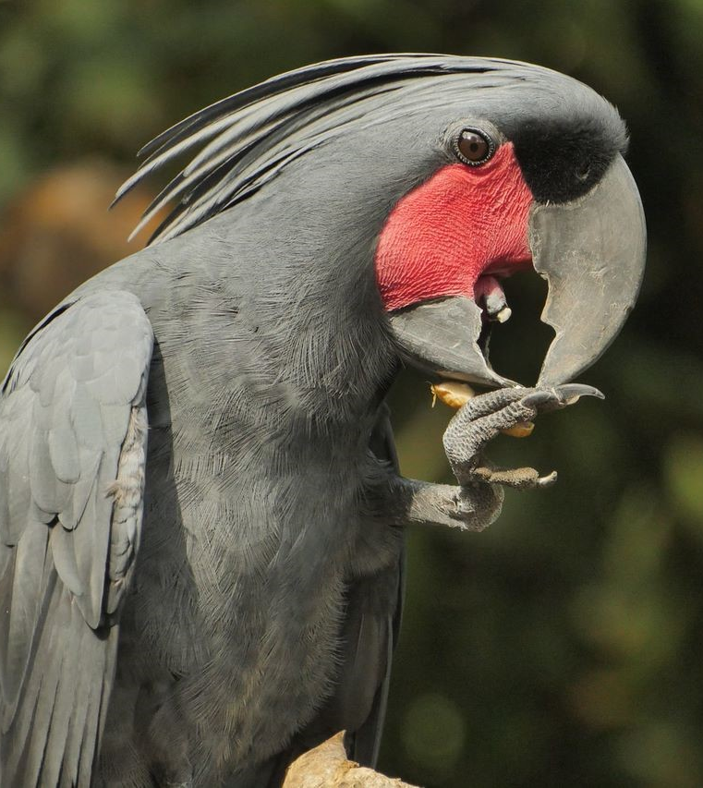
The Importance of Biodiversity for Business
2022

Slide 3
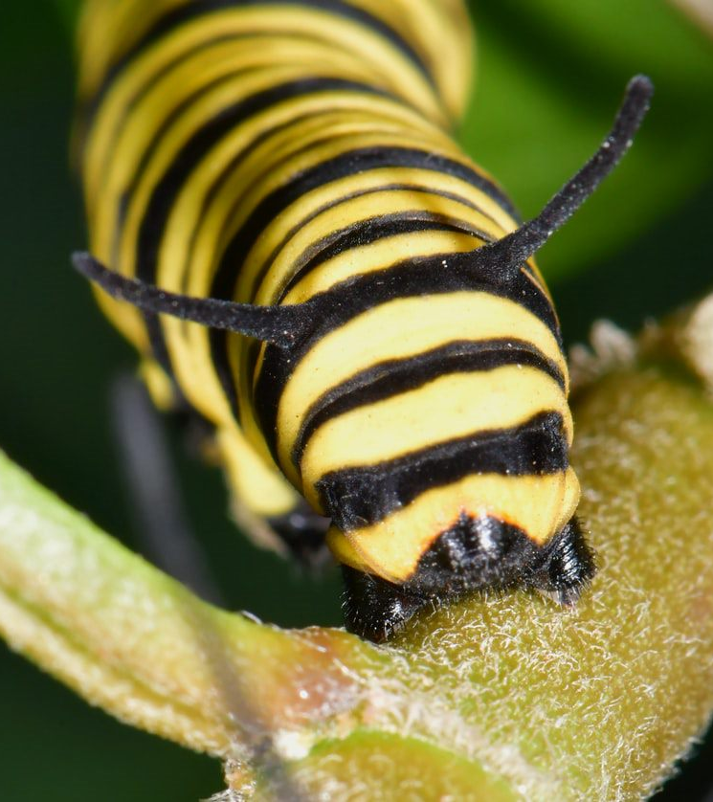
Overview
Setting the scene
The business case for biodiversity management
Opportunities for companies to respond
Tangible opportunities and risks in the near future

Slide 4

Setting the scene
Notes:
[This section will provide a background to ecosystem and species decline, and the drivers identified within the IPBES Report as well as the key messages of the recent Dasgupta Review]
Notes on slide transition:
Slides 5 – 7 introduce some of the key findings from the IPBES Global Assessment demonstrating that species and ecosystems are in decline as a result of various direct and indirect drivers.
Slides 7 – 9 build from this by introducing the Dasgupta Review which found that the imbalance between our demands on nature and nature’s ability to supply is leading to a decline in natural capital.
Slide 10 shows the need for solutions that integrate biodiversity, climate and society to build resilience into the future.
Slide 11 highlights the need to account for nature and shift financial flows to enhance stocks of natural assets.

Slide 5
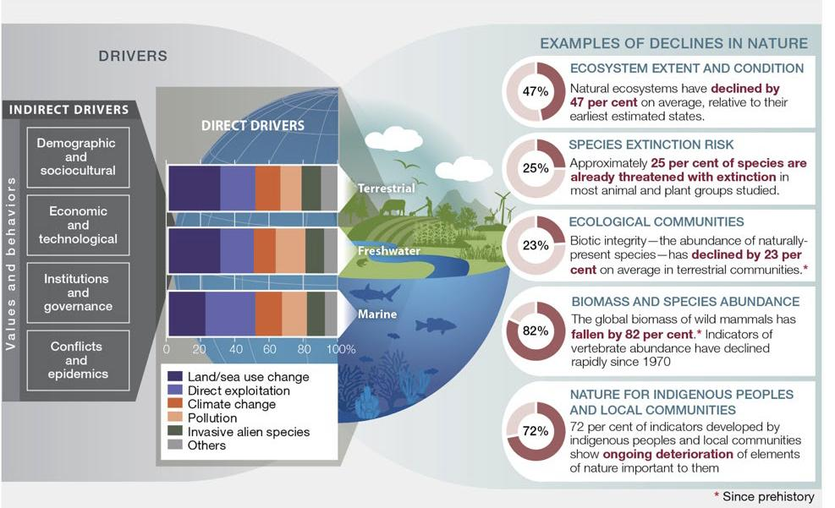
Source: IPBES (2019)
Notes:
The 2019 Global Assessment by the Intergovernmental Science-Policy Platform on Biodiversity and Ecosystem Services, identified direct and indirect drivers of biodiversity loss.
All of the direct drivers are relevant to the mining sector.
The key messages of the report are:
Nature and its contribution to people is deteriorating;
Direct and indirect drivers of biodiversity loss have accelerated over the past 50 years;
We can’t meet our short term conservation goals, and will only meet longer term goals with transformative change;
Nature can be conserved and sustainably used if we make urgent and concerted efforts.
Graphic (from left to right):
Indirect drivers (such as sociocultural behaviours) and direct drivers (such as land use change) impact the terrestrial, freshwater and marine spheres of nature.
Land use change has the biggest impact in the terrestrial sphere (ca. 30%), while direct exploitation has the biggest impact in the marine sphere (ca. 35%).
Examples of declines in nature for all three spheres are provided in the list on the right.
Source: https://www.ipbes.net/global-assessment

Slide 6
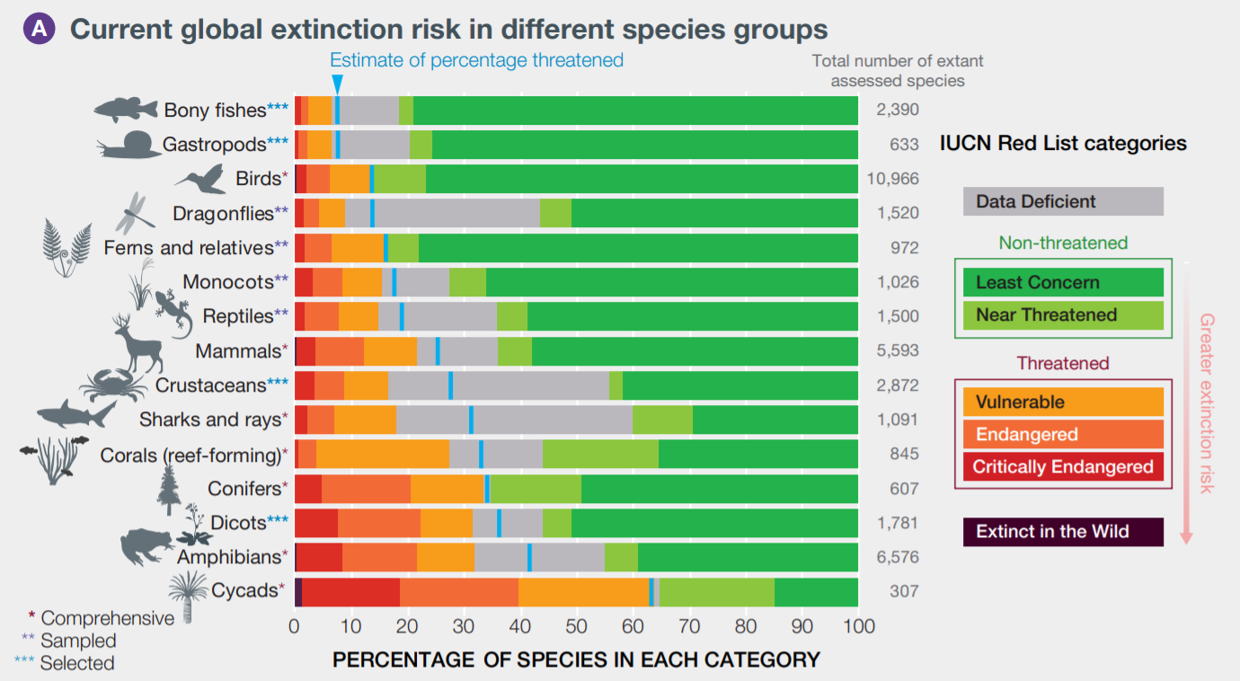
Source: IPBES (2019)
Notes:
These drivers now threaten species with extinction more than ever before. The IPBES report highlights around 1 million species are potentially at risk of global extinction (IPBES, 2019)
The image shows the percentage of species threatened with extinction in taxonomic groups by the International Union for Conservation of Nature (IUCN) Red List of Threatened Species. Groups are ordered according to the best estimate for the percentage of extant species considered threatened.
Source: https://www.ipbes.net/global-assessment

Slide 7
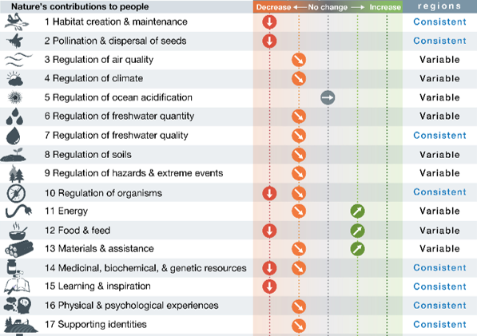
Many of the world’s ecosystems services are in decline
17 of 18 categories assessed have undergone decline
Benefits of nature to people are not easily replaced or replicated when lost
Source: IPBES (2019)
Notes:
The world’s species and ecosystem services are in decline which affects natures’ ability to provide services to people. These cannot be easily replaced or replicated when lost. (IPBES, 2019)
Source: https://www.ipbes.net/global-assessment

Slide 8
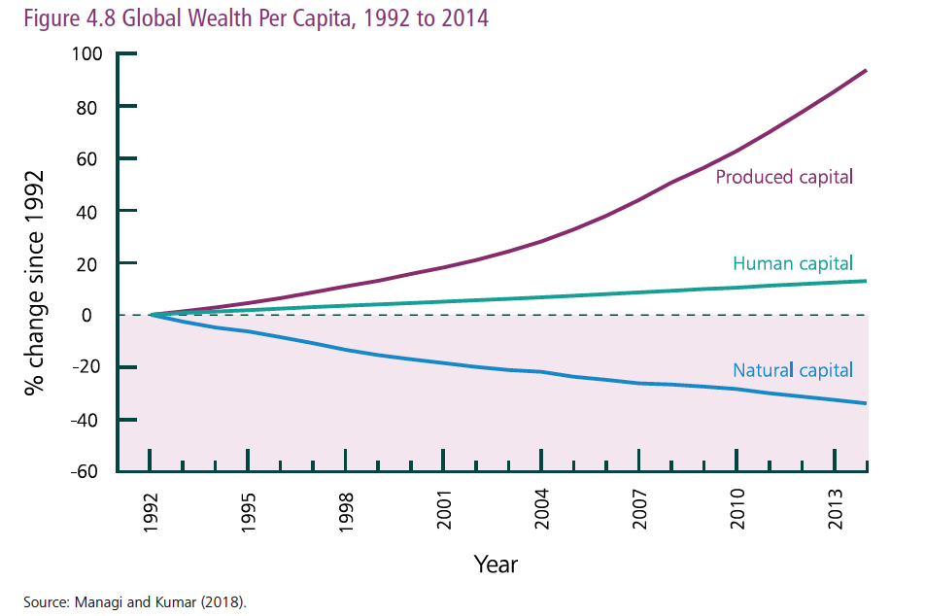
DASGUPTA REVIEW: Decline of Natural capital
Notes:
The recent release of the Dasgupta review focusses on the imbalance between our demands on nature and nature’s ability to supply described as the impact inequality.
We as a society are accumulating produced and human capital at the expense of natural capital by prioritising economic growth and development, leading to devasting costs to Nature. (Dasgupta Review, 2021)
The image shows Managi and Kumar’s estimates of global per capita accounting values of the three classes of capital goods over the period of 1992 to 2014. Globally produced capital per head doubled and human capital per head increased by ~13%, but the value of natural capital per head has declined by nearly 40%.
Source: https://assets.publishing.service.gov.uk/government/uploads/system/uploads/attachment_data/file/962785/The_Economics_of_Biodiversity_The_Dasgupta_Review_Full_Report.pdf
Original Image Source: https://www.taylorfrancis.com/books/inclusive-wealth-report-2018-shunsuke-managi-pushpam-kumar/e/10.4324/9781351002080

Slide 9
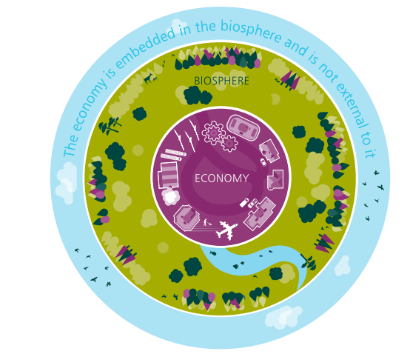
our economy is embedded within the biosphere
Notes:
Human, produced and natural capital are all interconnected, with our economy being embedded with biodiversity and not external to it.
Biodiversity enables the biosphere/nature to be productive, resilient and adaptable, reducing the risks and uncertainty posed to society and the economy.
Despite the interlinkages between our economy and nature, the goods and services which nature provides, is not reflected within the ways we measure wealth.
This means nature/biodiversity being undervalued in economic terms and the depreciation of natural capital is not accounted for (Dasgupta Review, 2021)
Source: https://assets.publishing.service.gov.uk/government/uploads/system/uploads/attachment_data/file/962785/The_Economics_of_Biodiversity_The_Dasgupta_Review_Full_Report.pdf

Slide 10
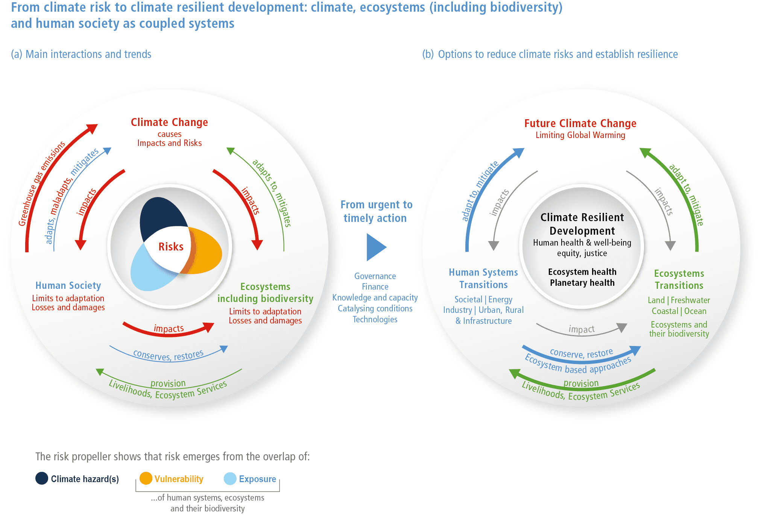
requiring whole of society solutions
Source: IPCC WGII (2022)
Notes:
Our systems are coupled and solutions need to focus on the interactions among climate, ecosystems & biodiversity and human society. If not tackled correctly these can form the basis of emerging risks but with urgent and timely actions there are opportunities to build towards climate resiliency, ecosystem & planetary health and human health and wellbeing.
Source: https://www.ipcc.ch/report/ar6/wg2/downloads/report/IPCC_AR6_WGII_SummaryForPolicymakers.pdf

Slide 11
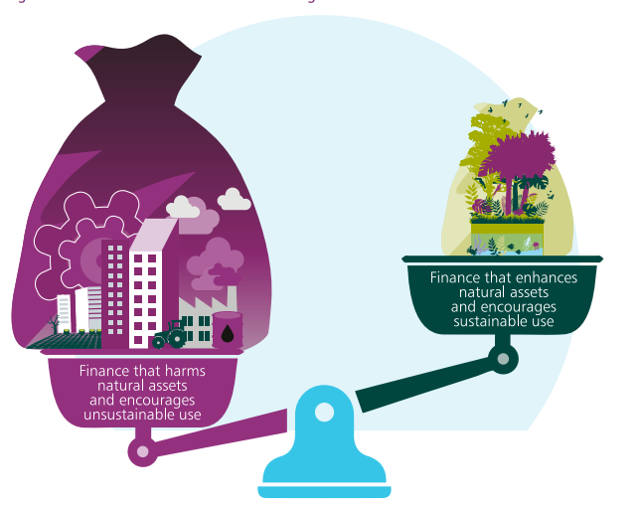
shifting financial flows
The cost of stabilising biodiversity intactness now by 2050 is approximately US$7 trillion dollars (~8% of global GDP).
But, delaying action by 10 years would more than double the cost to approximately US$15 trillion (~17% of global GDP)
Notes:
Restoration of biodiversity is more expensive than the conservation of it. Acting now is essential to reduce overall cost for society. (Vivid Economics)
Currently, the economy is incentivised to invest within activities which depreciate the value and stock of natural capital, leading to underinvestment within natural assets and increased investment within produced and human capital. (Dasgupta Review, 2021)
The scales need to rebalanced to ensure financial flows which enhance the stock of natural assets and, encourage sustainable consumption and production activities are increased. (Dasgupta Review, 2021)
Source: https://www.vivideconomics.com/wp-content/uploads/2021/02/210211-The-Urgency-of-Biodiversity-Action.pdf
Source: https://assets.publishing.service.gov.uk/government/uploads/system/uploads/attachment_data/file/962785/The_Economics_of_Biodiversity_The_Dasgupta_Review_Full_Report.pdf

Slide 12
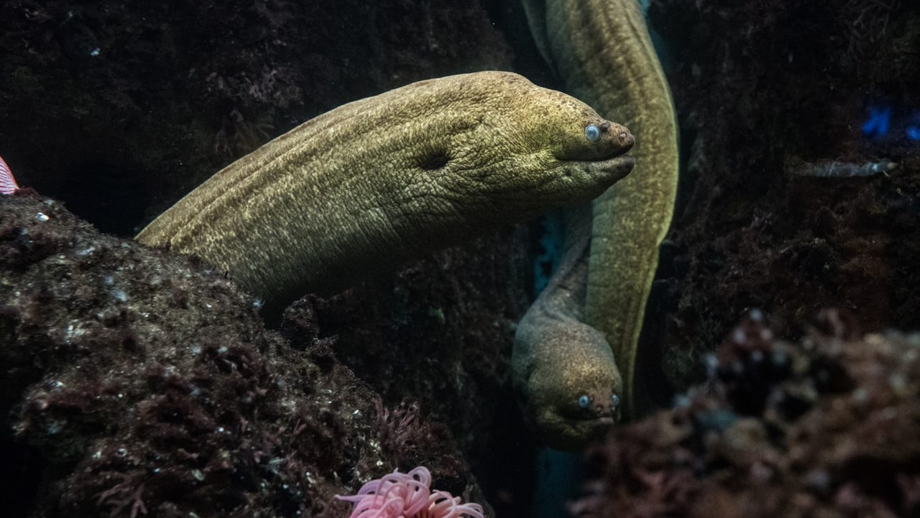
The business case for biodiversity management
Notes:
[This section will provide some key messages from the World Economic Forum’s Global Risk and Nature Risk Rising reports, a background to understanding biodiversity in the context of investor profiles and perceptions, and an overview of developments in policy and the finance sector]
Notes on slide transition:
Slides 13 looks at the gaining prominence of biodiversity within the WEF Global Risks Report and introduces how businesses impact and depend on biodiversity.
Slide 14 builds from this by introducing WEF Nature Risk Rising report which explored business dependencies on nature. The mining sector has moderate dependency and is therefore exposed to considerable risks from nature losses.
Slide 15 looks at how the mining sector poses a risk to biodiversity, particularly in forested areas. This could also be seen as an opportunity for positive biodiversity management.
Slides 16 - 19 explore investor profiles and perceptions of risk to demonstrate how company management of biodiversity risk is key to responding to investor metrics and disclosure expectations.

Slide 13
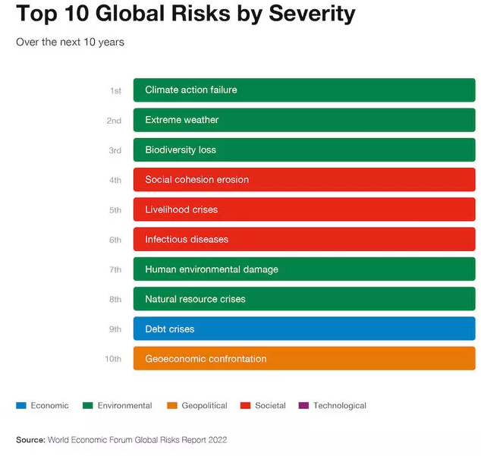
The Global Risk Landscape 2022
Biodiversity loss is increasingly seen as a material business risk
Most businesses impact and/or depend on biodiversity, either directly or through their supply chains
Over the past years the biodiversity loss risk has been consistently recognised as one of the top global risks
Notes:
For the past 5 years, the World Economic Forum Global Risks Report listed biodiversity loss and ecosystem collapse to be one of the top risks in terms of likelihood and impact within the coming 10 years. Over the past years, biodiversity loss risk gained importance and in 2022 it featured in the top 3 global risks by severity over the next 10 years (WEF, 2020; WEF 2021; WEF 2022)
It is important for businesses to recognize that they depend on biodiversity, either directly i.e. at the site level, through things like the control of erosion from forest preservation or indirectly i.e. through supply chain security.
Sources:
http://www3.weforum.org/docs/WEF_The_Global_Risks_Report_2021.pdf
https://www.weforum.org/reports/nature-risk-rising-why-the-crisis-engulfing-nature-matters-for-business-and-the-economy

Slide 14
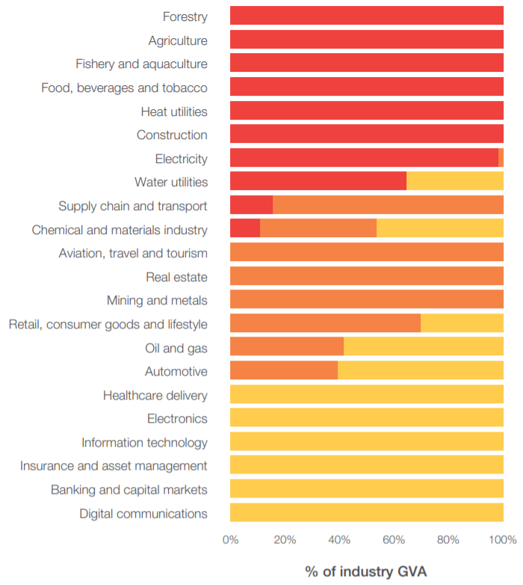

This translates TO Potential disruption for businesses
Percentage of direct gross value added (GVA) with high, medium, low nature dependency, by industry
Globally, $44 Trillion of economic value generation are at risk from nature loss (50% of Global GDP)
Apart from direct dependencies, businesses still have “hidden dependencies” through their supply chains
Source: World Economic Forum (2020)
Notes:
Dependency on nature can vary considerably between different industries and sectors and translate to real disruption risk for businesses. (WEF, Nature Risk Rising)
Mining is a sector which has moderate dependency on nature and it’s services, therefore exposed to considerable risks from nature loss.
Source: https://www.weforum.org/reports/nature-risk-rising-why-the-crisis-engulfing-nature-matters-for-business-and-the-economy

Slide 15
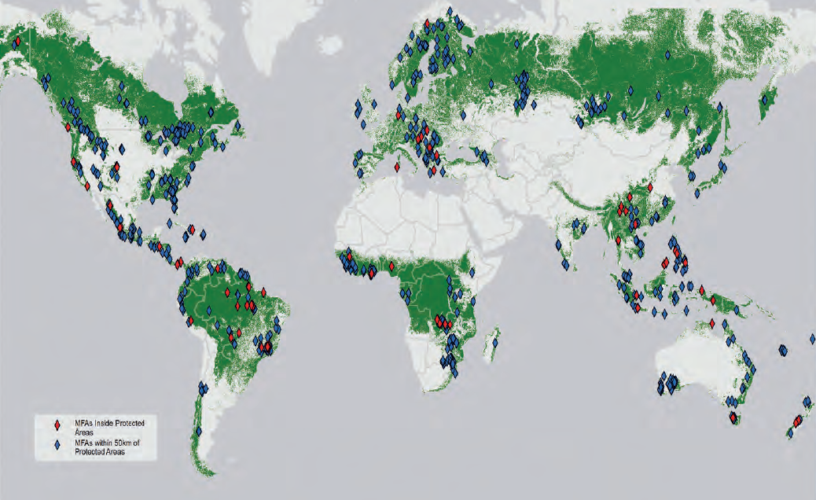
The ACTIVITIES of the Mining sector pose threats to biodiversity if not well managed
Source: World Bank (2019)
Notes:
Mining as a sector poses a risk to biodiversity if not well managed.
With one third of global forests within the potential sphere of influence of a mining project there is considerable scope for mining to have significant negative effects on biodiversity. (World Bank, 2019)
Conversely there is a real opportunity for mining to become a significant positive force in the management of biodiversity.
This map shows the large-scale mines in forested areas that exist inside or proximate to a Protected Area (PA). Green areas represent forest cover, red diamonds represent areas of Mines in Forested Areas inside Protected Areas and blue diamonds represent areas of Mines in Forested Areas proximate to Protected Areas.
Source: https://openknowledge.worldbank.org/handle/10986/32025

Slide 16
Risk Cannot be managed without Understanding biodiversity
Investor profiles and priorities are changing
Understanding biodiversity helps interpret metrics, anticipate investor expectations, and understand how the approach compares to peers
Companies need to understand biodiversity to avoid misinterpretations and engage with future investors
95% of millennials and 85% of all investors are now interested in sustainable investing strategies
Morgan Stanley 2020
Institutions with over $14 trillion in assets have committed to divesting from oil & gas in a movement often led by students
Fossil Free 2021
Notes:
Understanding biodiversity will enable you to interpret and respond to the metrics and expectations of investors and understand the company’s approach in relation to that of peer companies.
Millennials as a cohort are just beginning to enter their peak earning years. As a generation they are the most sustainably minding and twice as likely as previous generations to divest from companies that are considered unsustainable or from commodities that are not responsibly sourced.
Morgan Stanley predict that over the next 20 years ethical investment will alter the face of markets with a growing emphasis on the ability of Investor Relations teams to communicate the positive work companies have been doing in a language that resonates with new investors.
Speaking a common language around biodiversity and understanding the basics will enable you to stay ahead of this curve and appropriately communicate the work it is doing in a way that engages new investors.
Sources:
https://www.morganstanley.com/press-releases/morgan-stanley-survey-finds-investor-enthusiasm-for-sustainable-
https://www.morganstanley.com/content/dam/msdotcom/infographics/sustainable-investing/Sustainable_Signals_Individual_Investor_White_Paper_Final.pdf
https://fortune.com/2020/12/27/shareholders-esg-investment-funds-capitalism/
https://gofossilfree.org/divestment/commitments/

Slide 17
Investor perception of Key risks to mining companies from biodiversity loss
Transition
e.g. increased costs due to biodiversity change; reputational loss due to way a company’s biodiversity-related activities or overall brand are perceived by key stakeholders
Physical
e.g. rating downgrades and share-price losses, stakeholder relations, operational risk
Legal & regulatory
Systemic
e.g. costs from changes in licenses, permitting and compliance, fiduciary duty
e.g. shifts in customer preference towards more sustainable products; threats to markets from global/regional biodiversity loss, resource security
All can affect investment value in short, medium and long term
Notes:
A recent report by the Principles for Responsible Investment looked at investors’ perceptions of key risks to companies from biodiversity loss. The report highlights how global biodiversity and ecosystem service loss impacts businesses as a result of transition, physical, litigation and regulatory, and systemic risks, which have the potential to affect investment value in the short, medium, and long term. (UN PRI, 2020)
Transition risk towards an economy that conserves and restores biodiversity can result in increased costs due to biodiversity changes (UN PRI, 2020), reputational risks due to a company’s approach to biodiversity-related activities or wider brand perception by key stakeholders (UNEP FI, 2020).
Physical risk are the physical impacts of biodiversity loss, which include rating downgrades and share price losses as well as operational risks associated with biodiversity loss (UNEP FI, 2020)
Legal and regulatory risks arise from the litigation and breach of underlying legal frameworks, and changes to regulation. This could result in a potential failure to comply with existing legislation, or new or increased costs from changes in licenses, permitting and compliance (UN PRI, 2020).
Systemic risk includes systemic impacts of biodiversity loss, such as market risks arising from shifts in consumer preferences towards more sustainable products (UNEP FI, 2020) as well as threats to markets from global/regional biodiversity loss.
Sources:
https://www.unepfi.org/wordpress/wp-content/uploads/2020/06/Beyond-Business-As-Usual-Full-Report.pdf
https://www.unpri.org/download?ac=11357

Slide 18
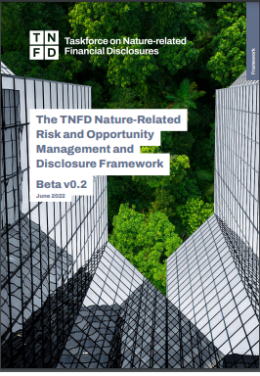
finance sector scrutiny
Biodiversity is rising up the agenda of the finance sector, driven by policy changes and civil society demands.
TNFD is emerging as a risk management and disclosure framework for organisations to report and act on nature-related risks
The International Sustainability Standards Board (ISSB) will deliver a comprehensive global baseline of sustainability-related disclosure standards to meet investor needs.
Notes:
Biodiversity is rising up the agenda of the finance sector, driven by policy changes and civil society demands, increasing the use and application of:
ESG criteria
Environmental, social and governance (ESG) criteria are a set of standards for a company’s operations that socially conscious investors use to screen potential investments. Environmental criteria consider how a company performs as a steward of nature. Social criteria examine how it manages relationships with employees, suppliers, customers, and the communities where it operates. Governance deals with a company’s leadership, executive pay, audits, internal controls and shareholder rights.
Financial disclosures
The finance sector is increasingly adopting recommendations for more effective climate or nature-related disclosures that promote more informed investment, credit, and insurance underwriting decisions and that enable stakeholders to understand the financial system’s exposures to climate and nature-related risks.
Reporting requirements
For example, the Global Reporting Initiative sets out requirements for corporate disclosure, including biodiversity

Slide 19
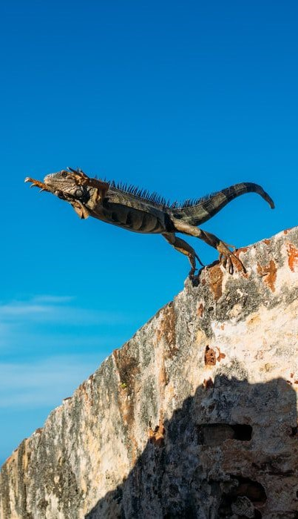
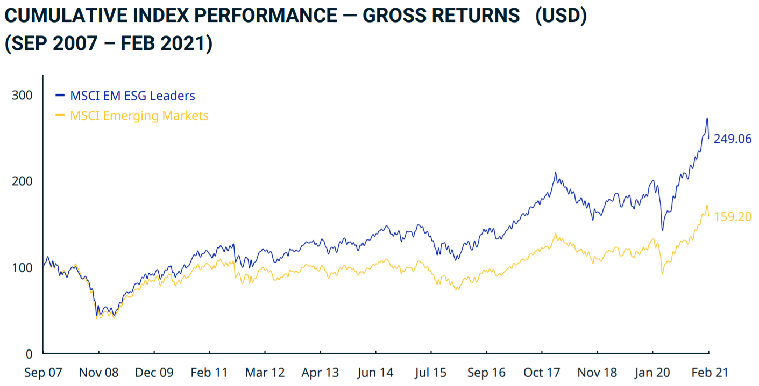
Esg integration as a market opportunity
“What we can say now is that the impact [of ESG issues] on risk, volatility and valuation is clearly statistically significant.”
- Guido Giese, Executive Director of Equity Research, MSCI
Source: MSCI (2021)
Notes:
ESG is now a key part of analysts’ work so companies need to ensure they are acting and reporting on biodiversity as it underpins the ‘E’ in ESG
This image shows the increasing evidence of a relationship between Environmental, Social, Governance (ESG) safeguard integration and company performance. Over the past decade, the MSCI Emerging Markets ‘ESG Leaders’ index has delivered annualised returns of 7.03% versus 3.52% for the regular MSCI Emerging Markets index.
There is increasing evidence between ESG performance and company performance – the MSCI index has shown a statistically significant relationship between integrated ESG safeguards and company valuation a profitability.
A BCG study of 180 companies in the US consistently showed that those adopting sustainability policies were outperforming others both in stock market and accounting performance.
McKinsey estimates a $3-4 trillion opportunity just in terms of resource productivity improvements from integrating ESG safeguards across the private sector.
While the sustainable business commission estimated a $12 trillion opportunity for the private sector related to delivering the SDGs.
Sources:
https://hbswk.hbs.edu/item/6865.html
https://www.msci.com/documents/10199/c341baf6-e515-4015-af5e-c1d864cae53e
https://www.mckinsey.com/~/media/McKinsey/Business%20Functions/Sustainability/Our%20Insights/Resource%20revolution/MGI_Resource_revolution_executive_summary.ashx

Slide 20
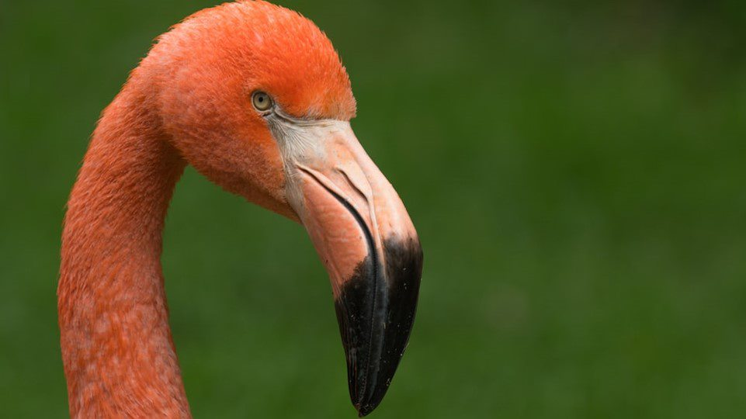
Opportunities for companies to respond
Notes:
[This section outlines the need for transition towards nature-positive economy and business models, and provides an overview of high level opportunities which companies can respond/contribute towards.]
Notes on slide transition:
Slide 21 introduces the global policy agenda, showing how businesses will have a key role in achieving the post-2020 global biodiversity framework.
Slide 22 introduces the global goal for nature and its three temporal objectives for achieving nature-positive.
Slides 23 – 25 explore the broader transitions that need to take place alongside this to support a transition towards nature-positive systems and business models. These slides provide and overview of the Dasgupta Review and the WEF Future of Nature and Business report to highlight (i) the three transitions for change (ii) the business and economic opportunity and (iii) the role of the mining sector
Slide 26 provides a framework for business action across 4 key areas: assess, commit, transform and disclose
Slide 27 draws out some high-level benefits for businesses in adopting good biodiversity management and Slide 28 explores how the mitigation hierarchy is a key tool for businesses to engage with and manage biodiversity.

Slide 21

The Convention on Biological Diversity
Post-2020 Global Biodiversity Framework
  21 targets and 10 ‘milestones’ for 2030
  ‘Living in harmony with nature’ by 2050
  Draft Target 15
    Businesses to measure and report dependencies and impacts
    Reduce negative and increase positive impacts
    Full sustainability of extraction and production practices
CBD COP15 PART I
(OCT 2021)
Adoption of Kunming Declaration
CBD RESUMED SESSIONS (MAR & Jun 2022)
Working group and subsidiary body meetings
CBD COP15 PART II
(DEC 2022)
Finalising Post-2020 Global Biodiversity Framework
Notes:
In late 2022, Governments will convene to finalize the negotiations on the post-2020 global biodiversity framework, setting out an ambitious plan to transform society’s relationship with nature and ensure that by 2050 the vision of living in harmony with nature is fulfilled.
Achievement of the goals and targets by 2030 will necessitate accelerated action from governments, business, financial institutions, indigenous peoples and local communities, and civil society. All of the goals and targets are relevant to and will shape the regulatory environment and global, regional and national economy.
Draft target 15 is directed at business action and is expected to focus on
1 assessing impacts and dependencies,
2 reducing negative impacts and increasing positive impacts
3 reducing risks and moving towards sustainability

Slide 22
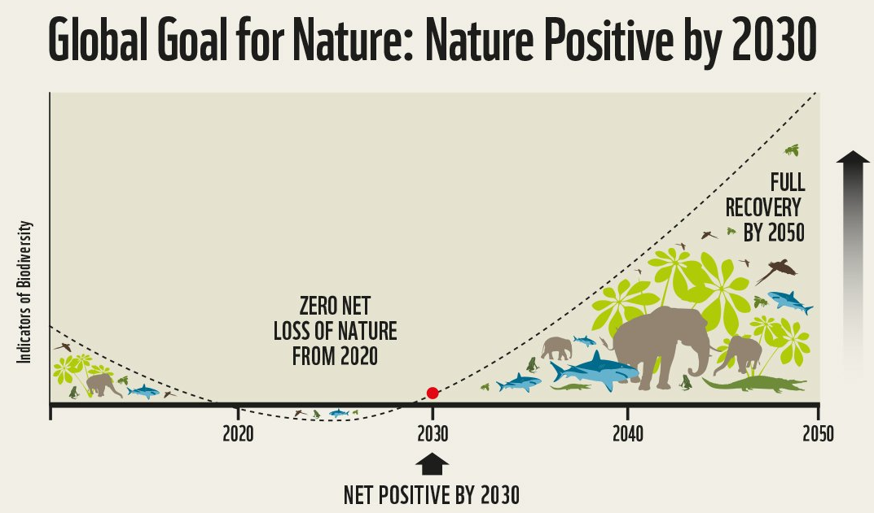
Notes:
In 2020 a wide-ranging group of NGOs and business organizations put forward a global goal for nature-positive as a clear call to action for more ambition and an overarching goal that could be integrated with other climate and development goals. The Global Goal for Nature outlines three temporal objectives, set against a baseline of 2020, to:
Achieve zero net loss of nature by 2020
Be nature net-positive by 2030
Have a full recovery of nature by 2050
Achieving these objectives will require transformations in the way business consider and act on nature.
Source: https://www.wbcsd.org/Programs/Food-and-Nature/Nature/News/Embracing-a-Global-Goal-for-Nature

Slide 23
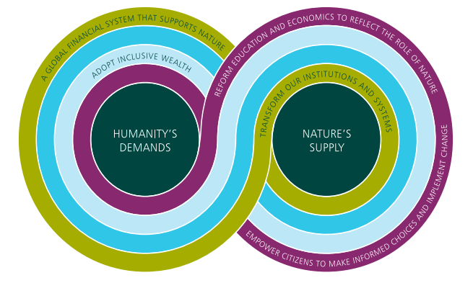
Dasgupta review – three transitions for change
Balance humanity’s demand with nature’s supply and increase supply relative to its current level
Change our measures of economic success
Transform our institutions and systems
Notes:
The Dasgupta review recommends three transitions for change which provide opportunity for businesses to contribute towards (Dasgupta Review, 2021).
The first aims to address the imbalance of our demands on nature and nature’s ability to supply to this demand. This change also focusses on increasing natures supply relative to its current level for sustainable use.
The second focusses on ensuring our measures of wealth are natural capital inclusive which considers the deprecation of nature and nature’s stocks.
The third suggests changing our current institutions to ensure nature is part of economic decisions.
Businesses can contribute to these three transformative changes by ensuring they consider biodiversity within their decision making and business activities.
Source: https://assets.publishing.service.gov.uk/government/uploads/system/uploads/attachment_data/file/962785/The_Economics_of_Biodiversity_The_Dasgupta_Review_Full_Report.pdf

Slide 24
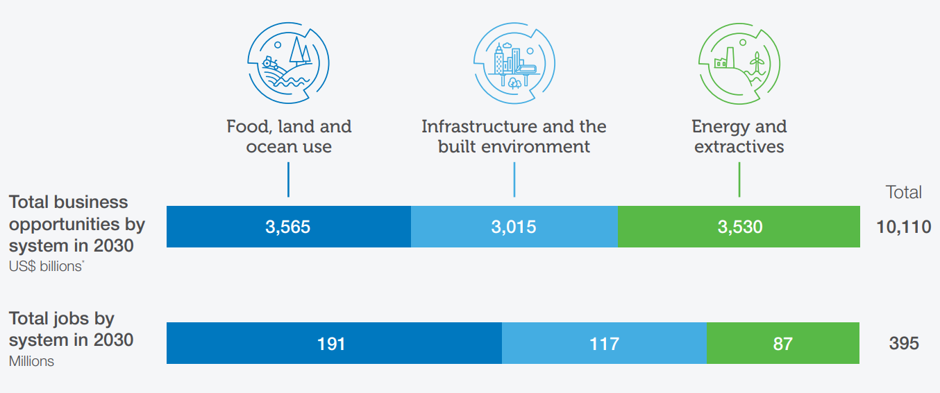
A Nature-positive transition presents business opportunities
Source: World Economic Forum (2020)
Notes:
In a report last year, WEF outlined 15 systemic transitions (presented on the next slide) with annual business opportunities worth $10 trillion that could create 395 million jobs by 2030.
Within the energy and extractives, emerging business opportunities over four transitions could create over 3.5 trillion worth of annual value and almost 87 million jobs by 2030.
Together these transitions can pave the way towards a people- and nature-positive development that will be resilient to future shocks.
This image shows how the three socioeconomic systems can lead to total business and job opportunities by 2030.
Source: http://www3.weforum.org/docs/WEF_The_Future_Of_Nature_And_Business_2020.pdf

Slide 25
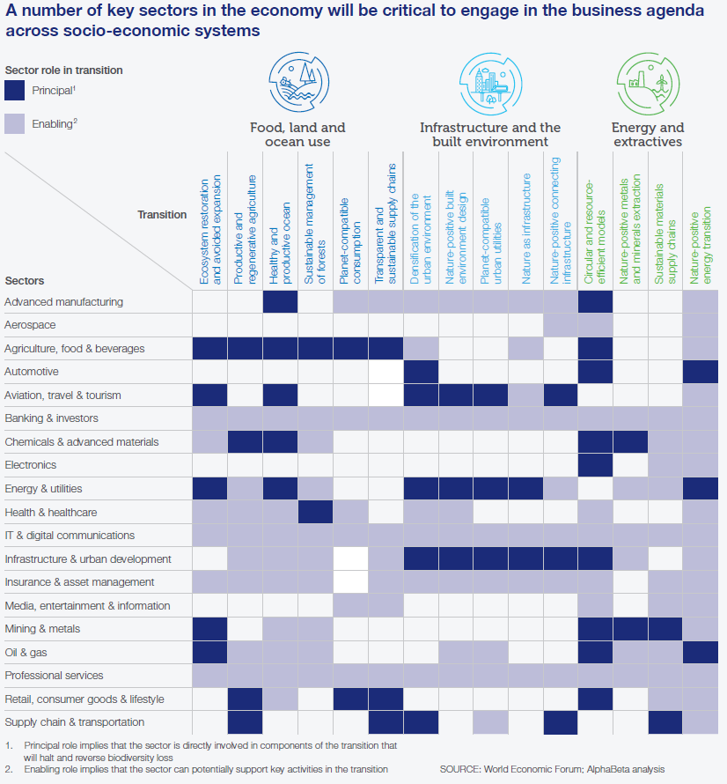
The mining sector will be critical to key transitions
These opportunities are not available under business as usual
The role of business within these transitions will vary by sector and region
Source: World Economic Forum (2020)
Notes:
The role of business within the these 15 transitions will vary by sector and region. The 15 transitions fall under three main socio-economic systems.
The transitions which are most pertinent to energy and mining sectors are those which focus on ecosystem restoration and avoided expansion under the nature-positive food, land and ocean use system use.
As well as circular and resource-efficient models, nature-positive metals and mineral extraction, and sustainable materials supply chains under the nature-positive extractives and energy system.
This graphic shows how a number of key sectors in the economy will be critical to engage within the business agenda across the three socio-economic systems.
Source: http://www3.weforum.org/docs/WEF_The_Future_Of_Nature_And_Business_2020.pdf

Slide 26
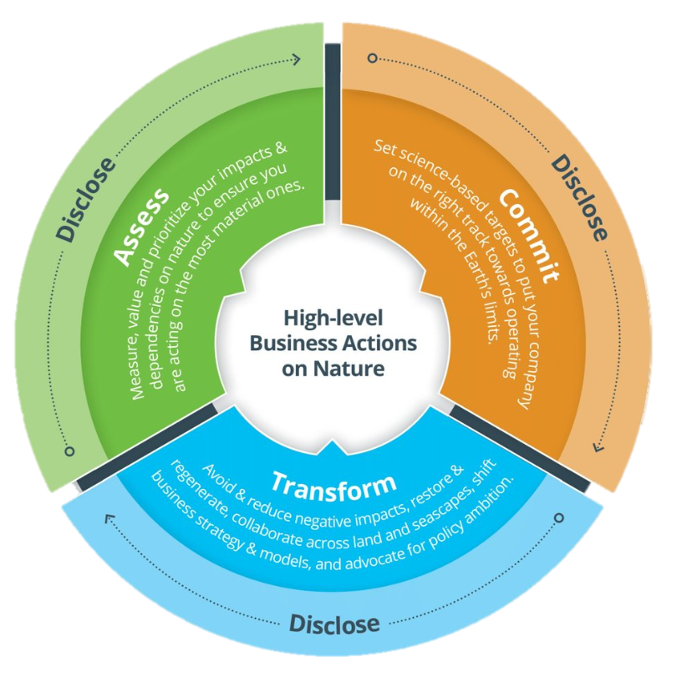
Business actions
The high-level business actions on nature provide companies with a framework to signal that they are making meaningful contributions to help reverse nature loss and contribute to an equitable, nature-positive world, where positive impacts outweigh negative ones.
Notes:
Achieving these transitions will require integrated action by business. Business for Nature’s ‘ACT-D’ framework guides businesses on how to act now to halt and reverse nature loss, and credibly contribute to a nature-positive world, with positive impacts outweighing negative impacts on nature. ACT-D builds on existing action frameworks and guidance and has four steps:
Assess
Commit
Transform
Disclose
Source: https://www.businessfornature.org/high-level-business-actions-on-nature
A note on alignment: These actions have been developed in collaboration with leading organizations. They build on existing action frameworks and guidance, including the Natural Capital Protocol, the Science Based Targets for Nature Initial Guidance for Business, World Business Council for Sustainable Development (WBCSD) building blocks ‘what nature positive means to business’, BfN Steps to becoming nature positive, Taskforce on Nature-related Financial Disclosures (TNFD) framework (currently in beta version).

Slide 27
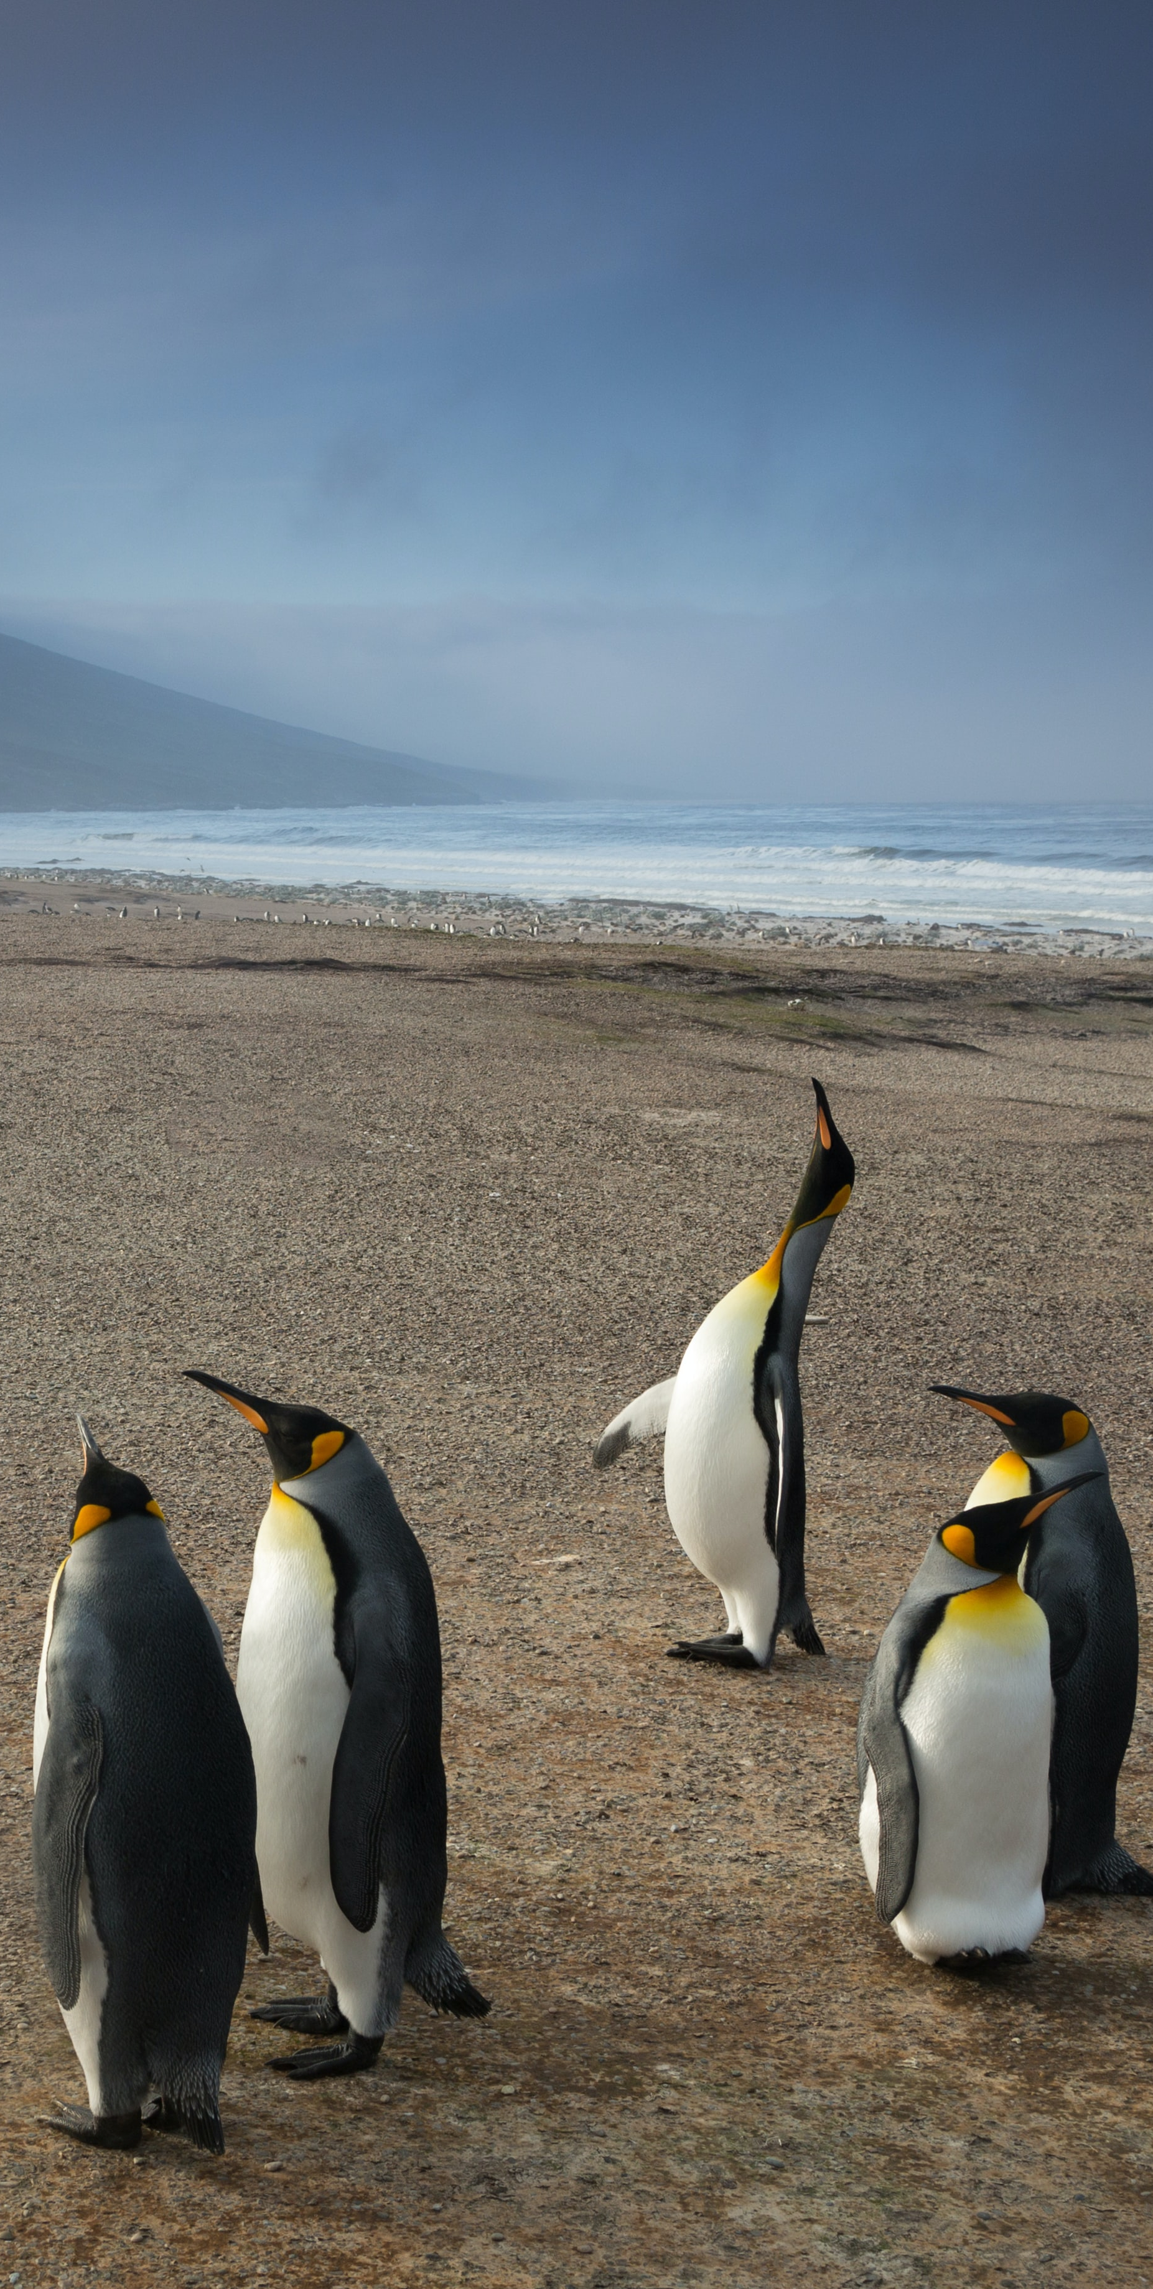
Good biodiversity management…
…leads to many benefits for business
Maintained access to finance
Continued supply of resources
Resilient operations
Supporting regulatory compliance
Increased/maintained reputation
Notes:
These are examples of how good biodiversity management can result in benefits for business.
Increased access to finance
Operations/projects set up correctly from the outset, reducing costs in the long run
More available financing on the whole (e.g. access to ethical investment funds if positive impacts can be demonstrated)
Continued supply
Supply secured through good practice impact management in busy landscapes
Resilient operations
Increased resilience of operations to environmental risks like climate change (e.g. mangroves protect from storm surges; forests anchor earth in place and reduce erosion and landslip risk)
Ability to anticipate and respond to changes in natural environment
Awareness of biodiversity-related risks in the field leading to increased ability to respond efficiently and effectively
Assured compliance
Ability to comply with national/international legal/regulatory requirements
Increased/maintained reputation
Positive perceptions among civil society, consumers, media, and other stakeholders

Slide 28
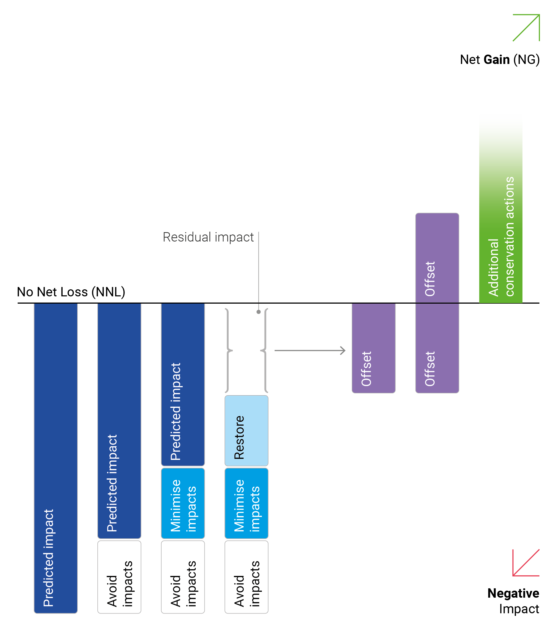
The question then becomes how…
Sequential steps to minimise negative impacts on biodiversity:
Avoidance
Minimisation
Restoration
Offsetting
Notes:
The Mitigation Hierarchy has been a pivotal tool in the arsenal of environment managers when addressing biodiversity interactions at a site level.
Here we have a visual representation of the mitigation hierarchy. The concepts of which, are applicable to the mining, oil & gas and finance sectors and beyond.
The mitigation hierarchy is applicable throughout a project’s lifespan.
It’s important to note that project sites will be selected through ecosystem-level Biodiversity & Ecosystem Services (BES) screening FIRST, during the pre-feasibility stage. AFTER THIS, we use the mitigation hierarchy to further avoid and minimize impacts within the project area.
Using the mitigation hierarchy therefore requires adaptive management during the construction and operation phases of a project, with clear understanding of the study areas, BES values and impacts and choice of mitigation options.
After the avoidance and minimization phase is complete, the next steps would be to determine appropriate restoration sites, followed by offsetting (which is the fourth and final step – one that should not be depended upon).
By working through the mitigation hierarchy, the hope it to achieve No Net Loss or Net Gain targets related to biodiversity (see green arrows here).
The mitigation hierarchy is so well established that it is highlighted within the decision of the Convention of Biological Diversity (called the CBD). Which in reality, means that international policy is now following this industry good practice.
Source: UNEP-WCMC, own elaboration

Slide 29
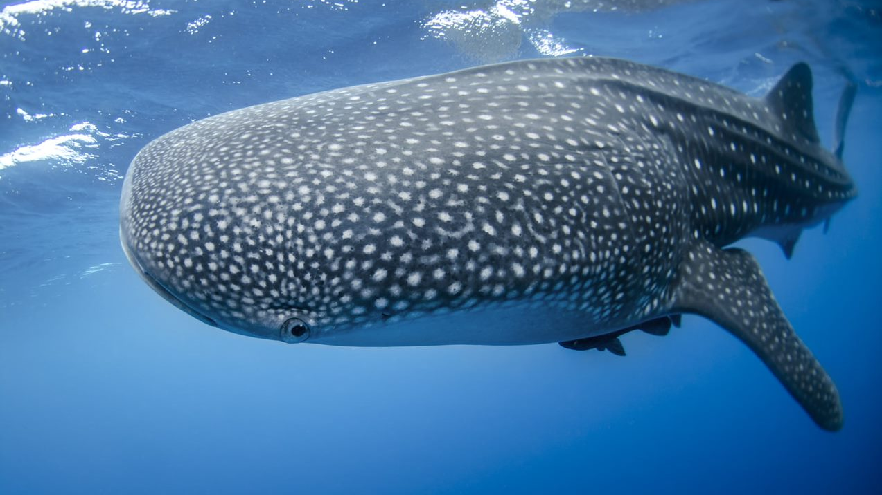
Tangible opportunities and risks in the near future
Notes:
[This section highlights tangible opportunities and risks at the company level which companies can act upon.]
Notes on slide transition. This section provides an overview of 4 different opportunities / risks so the slides are all independent of each other. In summary:
Slide 30 explores the role of Nature-based Solutions in advancing sustainable development.
Slide 31 looks at the connection between the energy transition and associated increase in metal & mineral extraction.
Slide 32 introduces the increased attention on marine mining and how this could lead to significant biodiversity impacts.
Slide 33 explores the potential for market consolidation and how this links to biodiversity-risk through asset acquisition.

Slide 30
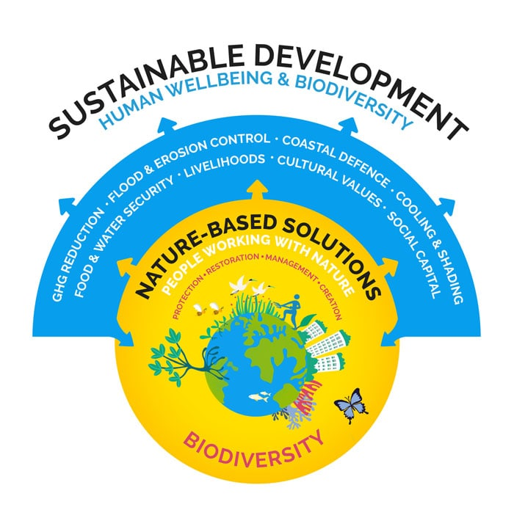
Nature based solutions
“Actions to protect, sustainably manage, and restore natural or modified ecosystems, that address societal challenges effectively and adaptively, simultaneously providing human well-being and biodiversity benefits”
–IUCN
Notes:
The private sector is increasingly integrating biodiversity as a theme in all decision making as the return on investment in other areas is substantial. For example: Nature Based Solutions (NbS)
Nature-based Solutions is an ‘umbrella concept’ for other established nature-based approaches, such as ecosystem-based adaptation (EbA) and ecosystem-based mitigation, green infrastructure, ecological engineering, eco-disaster risk reduction, and others.
The push for NbS is coming from multiple sources which include international policy, regional/national/ sub-national policy and at the company level.
NbS are relevant to businesses as they provide co-benefits that can align with and deliver aspirations (e.g. benefits for biodiversity, local livelihoods, and carbon sequestration).
Examples of NbS:
Mangrove restoration instead of engineered sea defences for protection of coastal assets (Replacement);
Restoring reefs to reduce the need for breakwater construction (Integrated/Hybrid);
Forest restoration to reduce siltation of hydropower dams and reduce dredging costs (Complementary).
Source:
https://www.iucn.org/theme/nature-based-solutions

Slide 31
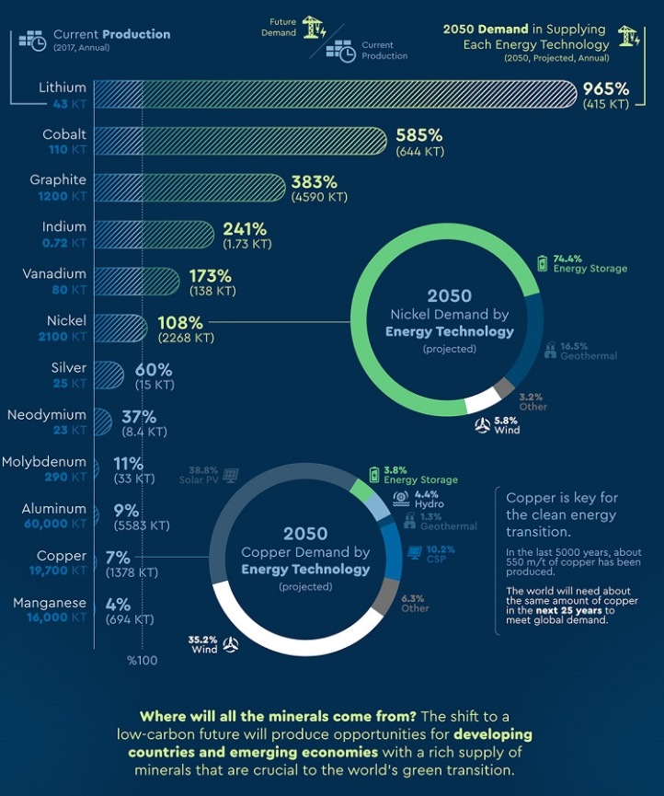
Energy transition
Essential shift to renewables to meet climate targets
Supply chain impacts of metal sourcing
Source: World Bank (2019)
Notes:
The energy transition to renewables could supply four-fifths of the world's electricity by 2050, which would massively cut carbon emissions and help to mitigate climate change.
However the transition will lead to significant increase of metal and mineral extraction, which has own direct impacts on biodiversity (habitat loss, pollution, over-exploitation, as some climate change impacts) and reserves of key minerals are found in areas of high biodiversity value, which leads to a new risks for biodiversity.
The WEF’s 2020 Report presented within the previous section outlined four key transitions for mining and metals.
Circular and resource efficient models – developing and implementing ways to reduce the amount of new resources required to satisfy our consumption needs.
Nature-positive metals and minerals extraction – striving to reduce the impact of extraction that is unavoidable in the metals and minerals sectors. This could include non-invasive exploration techniques, sustainable management of extractive sites, more-efficient extraction, and plans for extensive remediation of ecosystems and communities once extraction is complete.
Sustainable materials supply chains – working to integrate transparency and traceability into supply chains, which will help combat threat of illegal and environmentally degrading extractive activities. This could include conservation initiatives, mineral governance frameworks, new technologies and corporate commitments.
Ecosystem restoration & avoided expansion – ensuring that companies stabilise and reduce the footprint of their activities on ecosystems and simultaneously working to restore already degraded ecosystems. This could include no-deforestation policies in commodity supply chains, high carbon stock and high-conservation value approaches, or use of nature-based solutions to achieve science-based emission reduction targets.
Sources:
World Bank (2019) https://www.worldbank.org/en/news/infographic/2019/02/26/climate-smart-mining
World Economic Forum (2020) http://www3.weforum.org/docs/WEF_The_Future_Of_Nature_And_Business_2020.pdf

Slide 32
Marine mining
Pollution from waste water
Disruption to key life cycle processes (e.g. photosynthesis)
Habitat destruction from excavation
Affecting:
Fisheries,
Food webs,
Marine mammals,
Sea turtle,
Large predators,
Endemic species
Increased interest in marine and deep-seabed mining to meet demand for minerals
A lot of uncertainty: technologies new, marine environment poorly researched
Resolutions against marine mining at IUCN World Conservation Congress (Sep 2021)
Source: Fauna and Flora Int. (2020)
Notes:
A rising demand for certain minerals and metals for electronics and battery storage is leading to an increased interest in marine or deep-seabed mining.
We’re seeing people rush to secure rights to explore and extract minerals from the deep sea.
The technologies that are being developed are highly damaging to biodiversity, particularly in the marine environment where impacts have the potential to be much more widespread. For example, plumes from some deep sea mining activities can reach up to 100km away from the point where the impact occurred.
There is broad agreement across the scientific and conversation community that deep sea mining has potential to be a major threat to marine biodiversity.
The IUCN World Conservation Congress, which occurred in September 2021, adopted resolutions calling for a moratorium on marine mining.
Source: Fauna and Flora Int. (2020) https://cms.fauna-flora.org/wp-content/uploads/2020/04/FFI_2020_The-risks-impacts-deep-seabed-mining_Executive-Summary-.pdf
Source: https://www.iucncongress2020.org/motion/069

Slide 33

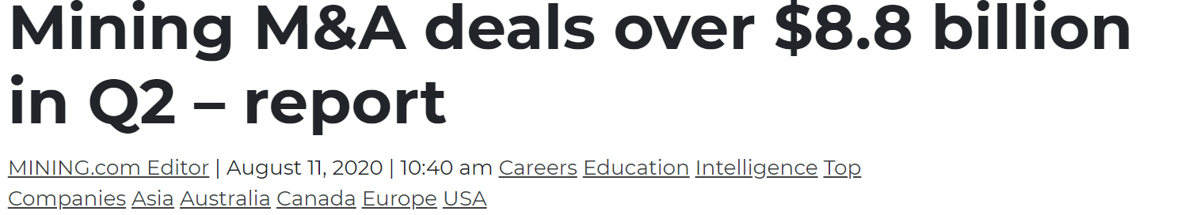
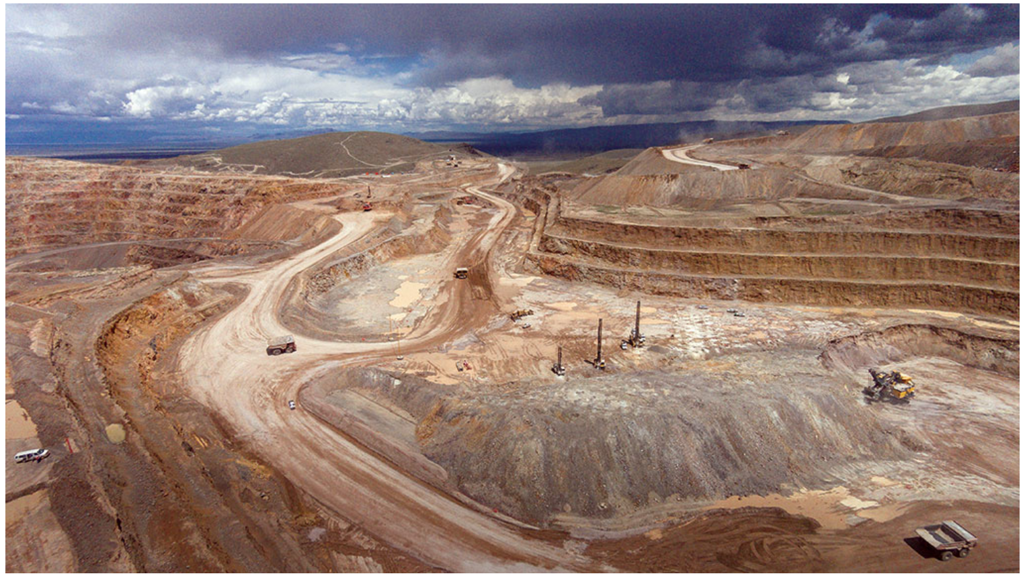
Market consolidation
Mergers or acquisition of assets (especially juniors) could pose a big biodiversity-risk to business
Newly acquired assets may have inherent biodiversity risk and the potential to become stranded assets or hold a high reputational risk
Potential for increased biodiversity risk at the portfolio level following acquisition of new assets
Notes:
The number of mergers and acquisitions within the extractives sector has increased.
Newly acquired assets could pose a big risk to businesses, as they may have an inherent biodiversity risk, have the potential to become stranded assets or hold high reputational risk.
Assets which have a lower biodiversity risk in isolation can fall beneath company risk screening thresholds. However, acquisition of such assets at scale increases the compound risk at a portfolio level.
Source: https://www.mining.com/global-mining-ma-deals-total-8-86-billion-in-q2-report/

Slide 34

The Business Case for Biodiversity

Slide 35
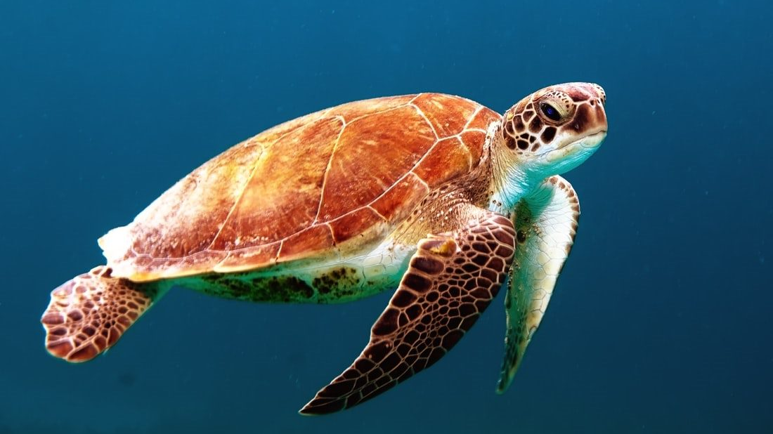
Thank you

Slide 37
References / Further resources
Dasgupta 2021. The Economics of Biodiversity – The Dasgupta Review. Available here.
IPBES 2019. Global Assessment Report on Biodiversity and Ecosystem Services. Available here.
IRP 2019. Global Resources Outlook 2019: Natural Resources for the Future We Want. Available here.
Maxwell et al. 2016. Biodiversity: The ravages of guns, nets and bulldozers. Available here.
WEF 2020. The Future of Nature and Business. Available here.
WEF 2020. The Global Risks Report 2020. Available here.
WEF 2020. Nature Risk Rising: Why the Crisis Engulfing Nature Matters for Business and the Economy. Available here
World Bank 2019. Forest-Smart Mining: Identifying Factors Associated with the Impacts of Large-Scale Mining on Forests. Available here.
UNEP et al. 2020. Beyond ‘Business as Usual’: Biodiversity targets and finance. Available here.
PRI 2020. Investor action on biodiversity: Discussion paper. Available here.
UNEP-WCMC 2020. A global mapping template for natural and modified habitat across terrestrial Earth. doi.org/10.1016/j.biocon.2020.108674.
UNEP-WCMC 2020. Biodiversity Measures for Business. Available here.
Locke et al 2020. A Nature-positive World: the Global Goal for Nature. Available here.

